Slide 1


eCREAM annual meeting · Košice · 15 and 16 October 2026
Everyone's data,
no one's risk
Federated analysis of emergency-department data with the Medical Informatics Platform, and the eCREAM federation running on it
Georges Melissargos · CHUV, NeuroDigital · WP5, Task 5.3 (integration with the MIP)
data stay in the hospitals · only results travel
Notes:
[0.5 min] Thirty minutes: twenty of slides, ten of live demo on the eCREAM federation. Most people in the room have never seen the MIP, so the first part is the idea and the evidence, then what eCREAM has running, then three decisions to take here.
The title is a promise. Everyone's data: the data of seventeen departments in three countries, soon more, usable by the whole consortium and, through the public instance, by anyone. No one's risk: no patient record ever leaves its node, nobody carries a copy, nobody signs for a transfer of identifiable data.

Slide 2





Emergency medicine has the data, and little of the research
THE DILEMMA
Free text everywhere
Option A: ship the files
Part of the clinical story lives in the notes, not only in the fields. Structured data alone miss some of what happened.
One copy per study, one agreement per copy, one more server holding patients' records. Someone carries the risk, every time.
Six countries, six languages, many EHRs
No two departments record the same thing the same way. Every study starts with months of curation, mapping, harmonization.
Option B: lock them away
Timing is the value, and the identifier
Perfectly safe. The knowledge stays in the drawer, and emergency medicine keeps producing very little reusable evidence.
Door-to-doctor minutes are quality indicators. Dates and times are also what re-identifies a patient.
Both options make the data someone's problem. The federated approach makes them everyone's resource, at no one's risk: that is what the next few minutes show.
Notes:
[1.5 min] Why emergency medicine is an unusually hostile place for data sharing: free text, heterogeneity across countries and languages, and timing that is both the scientific value and the re-identification risk. The two classic options both fail. Everyone in the room has lived this; keep it short and land the last line: there is a third way, and it is running.

Slide 3
Don't move the data.
Move the question.
That is the whole idea behind the Medical Informatics Platform.
Notes:
[0.5 min] Pause here. One sentence is the whole platform: the analysis travels to where the data live, runs there, and only the statistical result comes back. Everything that follows is machinery around this sentence.

Slide 4
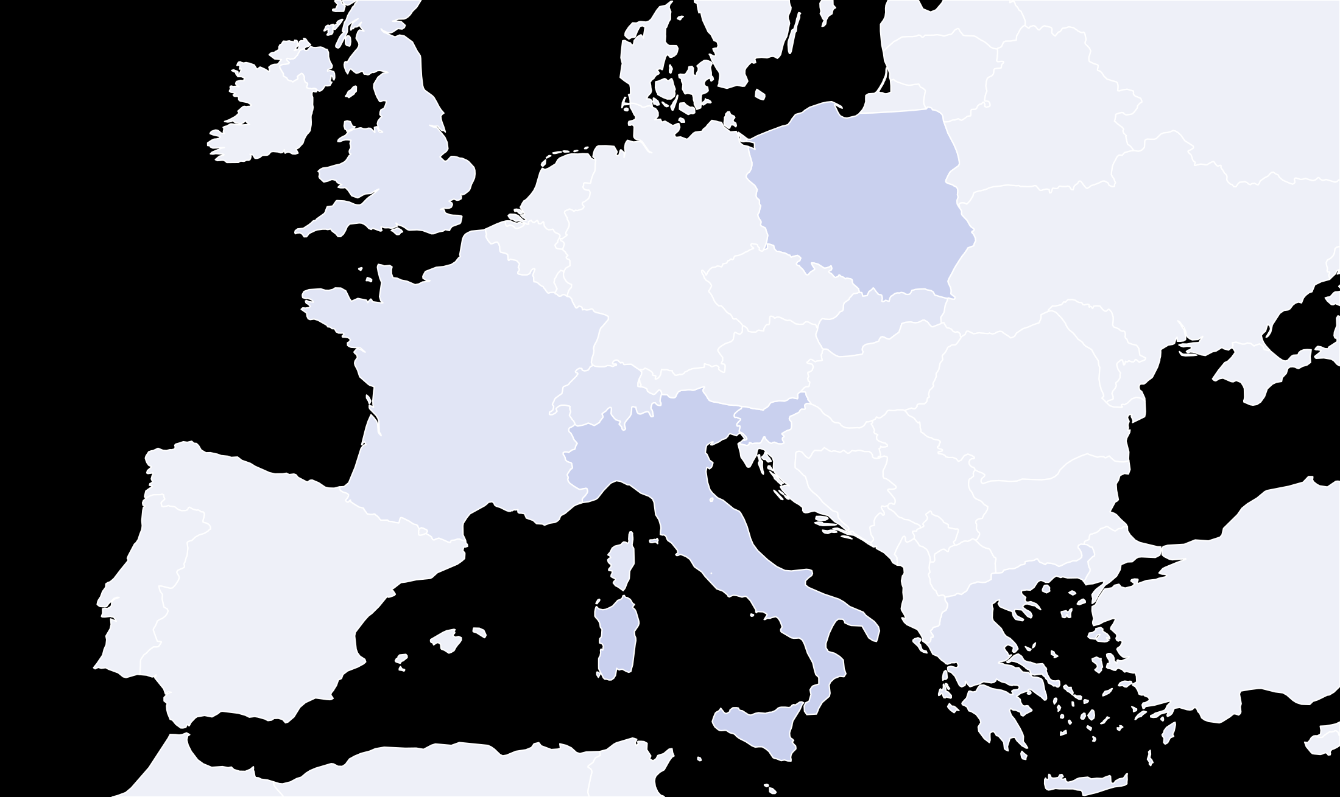




The question travels, the data stay home
HOW IT WORKS
An accredited researcher asks a question
EDs in the data model
other eCREAM countries
in a web page or a notebook: datasets, variables, filters, a method
United Kingdom
preparing
joining after local clearance
the question
17 EDs prepared, one hub
The question travels
Kraków, 3
Košice, we are here
the same specification goes to every node that holds a selected dataset, wherever it stands in Europe
Maribor
Each node computes at home
Bologna
on its own data, behind its own firewall; no file moves, no copy is made
MIP hub, CSCS Lugano
Vercelli
Bergamo
Pozzuoli
Milan, 2
Only statistics come back
Lodi
Turin area, 4
Alessandria
Catania
counts, means, coefficients, curves; the platform combines the node results into one answer
Lombardy and Piedmont: 10 of the 17 EDs
Heraklion, Crete
preparing
Nothing but the result travels. Seventeen departments in three countries today, more to come, answer the same question from where their data live; the platform combines the answers. There is no central database of patients to protect, because there is none.
Notes:
[2 min] Walk it left to right. The researcher never touches a file: she chooses datasets, variables, filters and a method. The platform sends that specification to every node that holds a selected dataset, and the map is the point: the nodes are real departments across Europe, the seventeen prepared in the data model today, in Italy, Slovenia and Poland, with the hub at CSCS in Lugano; the United Kingdom and Heraklion in Crete are consortium members working towards providing data too, and will join the roster once their local authorities clear it. Each node computes on its own data and returns statistics; the platform combines them. Code to data, not data to code. Say the last sentence of the banner out loud: there is no central database to protect because there is none.

Slide 5





The Medical Informatics Platform, in one slide
THE PLATFORM
Open source, born in the Human Brain Project
30+
500k+
12
built for neuroscience, now a general clinical-data service
A service of EBRAINS, the European research infrastructure
hospitals
patients
countries
nodes hosted at CSCS in Lugano, or inside the hospital
the MIP network as advertised by the public Data Catalogue, 2026
A web interface, nothing to install
and a notebook for those who code, since version 9.2
23 analysis methods
descriptives, tests, regressions, mixed models, clustering, classification
Every analysis is a saved experiment
re-openable, editable, shareable with other accredited users
A European research service in production, not a project prototype. eCREAM did not build a platform; it joined one, and brought emergency medicine to it.
Notes:
[1 min] Facts only. The MIP comes out of the Human Brain Project and is operated as an EBRAINS service, which is why access goes through an EBRAINS account. The catalogue figures are the network as a whole, all federations together. For the people who code: since 9.2 there is a notebook interface that goes through the same engine and gets the same statistics.

Slide 6




Five guarantees that hold on every screen
NO ONE'S RISK
Anonymized before entry
Data stay in place
No record-level access
Statistics only, ten or more
Accredited and traceable
Irreversible pseudonyms, no dates, no birth date, age capped at 90+. Fixed by contract, applied by the data provider.
Each dataset sits on its own node, behind the hospital firewall or on a dedicated secured node. Nothing is pooled.
No operation shows, exports or reconstructs an individual patient. The button does not exist.
A result resting on fewer than ten subjects is not returned. The engine enforces it, not a policy.
EBRAINS identity plus eCREAM accreditation, rights per dataset, every analysis recorded.
FAIR
by design
Findable
Accessible
Interoperable
Reusable
every federation, its scale, scope, entry point and full data model are listed in the public MIP Data Catalogue
accredited federated analysis for the consortium; the Public MIP for anyone with an EBRAINS account
one common data model per federation, csv and json formats, SNOMED CT bindings on the variables
anonymized datasets stay queryable after the project; every experiment is saved, re-openable and shareable
Metadata open, data closed. The data model of every federation is public; the data themselves never are. What stops a user pulling records out? The operation does not exist.
Notes:
[2 min] The slide that answers the question every data-protection discussion ends with: what stops a user pulling records out. The answer is that the operation does not exist, and the ten-subject floor is enforced by the engine. Anonymization happens before the data reach the platform, by the provider, under rules fixed in the agreement. Then the FAIR argument, in one strip: the platform is FAIR by design. Findable, because the catalogue lists every federation with its full data model; Accessible, because access is a governed, accredited service, and open on the Public MIP; Interoperable, because one common data model with standard formats and terminology bindings sits on every node; Reusable, because the anonymized datasets outlive the project and every analysis is a saved, shareable experiment. Metadata open, data closed is the FAIR angle in four words.

Slide 7




Tested on stroke first, published for both projects
PROOF
FERES, Federating European Registries for Stroke
5 national registries (Switzerland, Austria, Greece, Ireland, Italy), 945 common data elements, 149,772 patient events queryable in federated mode.
Frontiers in Disaster and Emergency Medicine, 2026
Deploying the Medical Informatics Platform for cross-border federated analytics in FERES and eCREAM
The showcase: 104,679 ischaemic strokes from the Swiss registry, split over two MIP nodes. The same adjusted analysis, run two ways:
Melissargos G, et al. Front Disaster Emerg Med 2026;4:1748193. Open access.
Centralized, pooled
Federated, two nodes
Governance first, and it takes time
weeks to onboard a user, months to onboard a new member
Patients
Patients
104,679
=
104,679
Harmonization is the critical step
Adjusted odds ratio (95% CI)
Adjusted odds ratio (95% CI)
clinical and data-engineering expertise together, every time
0.98 (0.94 to 1.03)
0.98 (0.94 to 1.03)
Effect sizes (d, V)
Effect sizes (d, V)
The statistics-only mindset has to be taught
0.39, 0.14
0.39, 0.14
training is part of the deployment, hence the hands-on sessions
Salerno A, Melissargos G, et al. Eur J Neurol 2026;33(8):e70715
Federated analysis is validated and the recipe is published. eCREAM reuses both: the same platform, the same governance pattern, the same method, applied to emergency-department data for the first time.
Notes:
[2 min] Left: FERES, the stroke project that shares infrastructure and method with eCREAM. The European Journal of Neurology paper is the methodological validation: one harmonized dataset of 104,679 patients, split across two MIP nodes, analysed once pooled and once federated; identical counts, the same adjusted odds ratio to the second decimal. This is why a federated UC1 analysis can be trusted to reproduce the centralized one.
Right: the Frontiers paper is the how-to for both projects, and its lessons are the ones that matter here: governance takes weeks for a user and months for a member, which is why the eCREAM agreement signed in October 2025 matters so much; harmonization is where the effort goes; and users need to be trained into the statistics-only way of working.

Slide 8
Part two.
eCREAM on the platform.
What the Grant Agreement asked for, and what is running today.
Notes:
[0 min] Switch from the generic platform to our own deployment.

Slide 9


One task, three configurations
WP5, TASK 5.3, LEAD CHUV WITH IRFMN AND ECRIN
eCREAM-MIP
Federated-MIP
Public-MIP
The restricted instance holding the central UC1 database. Accredited users only, double authentication, every analysis recorded.
Further MIP nodes at partner organisations, federating their harmonized datasets with the eCREAM instance.
An agreed subset of variables and datasets on the public EBRAINS instance, open to any registered user.
DELIVERED
READY, AWAITING NODES
NEXT
Two of the three exist today; the third is a decision away. Configurations 1 and 2 are one federation, reported in deliverable D5.2 (public, August 2026). The public instance already runs; it waits for the Steering Committee's variable list.
Notes:
[1 min] The Grant Agreement asked for three things. The restricted instance is delivered and running. The federated extension is a matter of partners deciding to host nodes, one of the decisions for this meeting. The public instance already exists as a platform; what is missing is the Steering Committee's variable list.

Slide 10




265 variables, one tree, four population blocks
THE DATA MODEL
UC1 · 265 variables
ONE VARIABLE, FULLY SPECIFIED
code
door_doctor_delay
ALL_PATIENTS
13 variables
DYSPNEA_AND_TLOC
131 variables
DYSPNEA_ONLY
40 variables
TLOC_ONLY
81 variables
label
Door to doctor
type · unit
integer · minutes
Logistic 4 arrival mode · triage code · mode of exit · arrival year
path
UC1 › ALL_PATIENTS › Time metrics › Process milestones
definition
ED arrival to doctor take-on; derived from two timestamps, which are then dropped
Demographics 2 sex · age
Time metrics 6 door-to-nurse · door-to-doctor · door-to-OBI decision · door-to-OBI transfer · door-to-admission decision · door-to-exit
How the model is used
The csv contract: one column per code, one file per ED
Dataset registry 1 which ED the record comes from
The tree the platform shows: navigate, pick, filter
The same model on every node: one question runs everywhere
the other three blocks open the same way: history taking, clinical examination, laboratory results, imaging, diagnosis, time metrics, each with its sub-groups
Public in the Data Catalogue: the variables for anyone, the data for no one
One data model is the contract between the EDs, the central database and the platform. Built from the UC1 dictionary with IRFMN, eight versions, every variable traceable to its source; version 2 is being prepared together as the real data arrive.
Notes:
[2 min] This is what a common data element is: a variable with a code, a label, a type, a unit, a place in a tree and a definition. Two hundred and sixty-five of them, organised by population block because a dyspnoea patient and a TLoC patient do not share all variables: 131 are common to both cohorts, the rest are cohort-specific. Open one block: the thirteen variables every patient has. The tree is what the platform shows when you pick variables, the codes are the column names of the csv each ED delivers, the catalogue publishes the whole tree, and every node speaks the same model, which is what makes one question run everywhere. Built from IRFMN's UC1 dictionary; version 2 is in preparation with them.

Slide 11
From a signed agreement to a running federation
D5.2, DELIVERED AUGUST 2026
1
2
3
4
5
6
7
Signed DTA
Anonymization fixed
265 CDEs
Harmonized samples
Synthetic scale
Federation live
Findable
October 2025
by contract
the data model
two 25-patient CRFs
two sets of 5,000
CHUV at CSCS
Data Catalogue
265
4
10 050
17
0
common data elements loaded as the data model
datasets loaded, selectable and analysable
subjects: 50 sample, 10,000 synthetic
per-ED datasets prepared for the real data
real patient records on the platform, by design
Everything production will use is in place: the agreement, the anonymization rules, the data model, the pipeline, the quality checks, the platform. What changes from here is the data, and that is the subject of the last slide.
Notes:
[1.5 min] Seven links, in dependency order: the agreement first, because without it nothing moves; the anonymization rules it fixes; the data model; the harmonization of real pipeline output, the 25-patient samples; synthetic data at scale to test the platform mechanically; the federation itself; and the public listing. Four numbers to remember: 265 variables, 4 datasets, about 10,000 subjects, 17 hospital slots. And one zero: there is not a single real patient on the platform yet, by design. All of it is in D5.2, a public deliverable.

Slide 12


Keeping the clock without keeping the dates
EVERYONE'S DATA, STILL USEFUL
In emergency medicine the value of the data is in the timing, and timestamps are exactly what makes a record re-identifiable. The agreement suppresses dates. So, every raw timestamp became a delay.
BEFORE
AFTER
arrival
2025-03-14 21:42
arrival_year
2025
nurse take-on
2025-03-14 21:55
door_nurse_delay
13
first ECG
2025-03-14 22:31
door_ecg1_delay
49
decision to admit
2025-03-15 01:10
door_decisionadmit_delay
208
ED exit
2025-03-15 03:04
door_exit_delay
322
minutes
26 such transformations, in minutes from ED arrival. Calendar dates disappear from the platform entirely; times-to-care, themselves UC1 quality indicators, stay fully analysable. Anonymization here costs nothing in analytical value.
Notes:
[1.5 min] The slide to linger on if anyone doubts that anonymization costs analytical value. Here it does not: door-to-doctor and door-to-decision are precisely what UC1 wants to compare between centres, and they survive intact, while no calendar date exists on the platform. Twenty-six such delays, plus the year of arrival. This is also the variable the demo uses next.

Slide 13
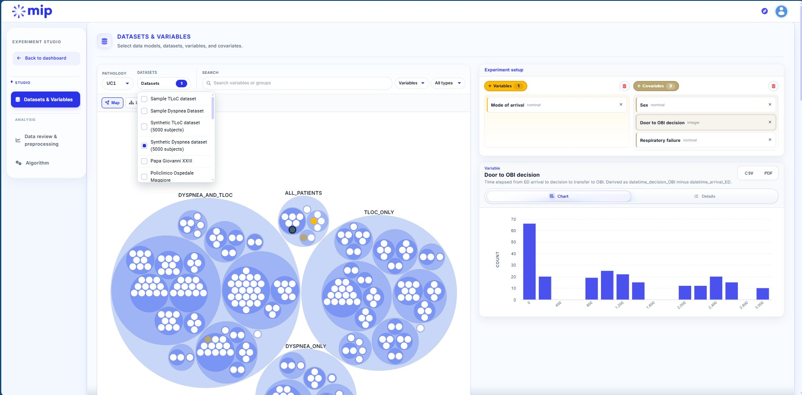
Who is seen by a doctor sooner: dyspnoea or TLoC?
LIVE, TEN MINUTES, ON THE ECREAM FEDERATION
LIVE DEMO · 10 MIN
1
Choose the data
UC1 pathology, both synthetic datasets (5,000 subjects each); variable Door to doctor; covariates Sex and Age.
10,000 records
2
Review before modelling
No filter. Per-dataset counts, missing values, distributions, side by side; the ten-subject rule already applies to every chart.
no missing values
3
Compare the cohorts
Independent t-test on the door-to-doctor delay, grouped by dataset.
the eCREAM federation: datasets and the variable tree
48 vs 105 min
What to watch for: no file opens, no row is shown, every number is a statistic computed where the data live, and the whole experiment is saved with its settings.
4
A categorical look
Chi-squared test, Sex by dataset.
68% vs 48% male
5
Save the experiment
It becomes a named, re-openable, shareable object in My experiments, not a screenshot.
saved, shared
Synthetic data, real workflow. The contrast is plausible (visible breathlessness is seen faster than a collapse that has resolved), but the finding is not a result: the point is that the platform runs end to end on the eCREAM data model, with the guarantees of slide 6 holding on every screen.
Notes:
[10 min] Switch to the browser. Say the question out loud before touching anything, then let the platform answer it: both synthetic datasets, door-to-doctor delay with sex and age, no filter, independent t-test grouped by dataset, chi-squared on sex, save. Narrate the guarantees while clicking: no file, no row, statistics only, saved experiment. Expected values: dyspnoea mean 47.8 min (median 41), TLoC 105.3 (median 53); 68% versus 48% male. The screenshot on the slide is the same screen as the demo's first step: if the connection fails, present from the slide (steps, expected numbers) and the exact settings in the appendix. Do not oversell: synthetic data, the workflow is the demonstration.

Slide 14





The same platform, open to anyone with a free EBRAINS account
EVERYONE'S DATA · THE PUBLIC MIP · HBPMIP.LINK
Try it this week
International Stroke Trial
Diabetes, 130 US hospitals
NHAMCS emergency department survey
National Hospital Care Survey
1
Register at ebrains.eu/sign-up. Automatic with an academic or research e-mail address; a company address is validated by hand, so allow a few days.
19,435 randomised stroke patients, 1991 to 1996, 36 countries
101,766 inpatient encounters, 1999 to 2008
86,864 US emergency visits, 2018 to 2022
1.86 million encounters, 2020 to 2022, inpatient and ED
120 variables
64 variables
254 variables
100 variables
2
Open hbpmip.link and sign in with that account.
Four open clinical datasets curated and loaded by CHUV in 2026, each with step-by-step teaching scenarios and expected results; alongside 1,032 real anonymized dementia records (Leenaards Memory Centre) and synthetic cohorts in epilepsy, mental health and TBI. 23 analysis methods, nothing to install.
Pick a dataset, follow a teaching scenario, run your first federated analysis in half an hour.
3
For eCREAM: the public subset of UC1 will land here as additional datasets once we decide the variable list. Nothing to build, only to decide.
An open invitation. Everyone in this room can be running an analysis on the Public MIP before the end of the week, with the same interface and the same guarantees as the eCREAM federation. Try it, and you will know what accredited access to the eCREAM data will feel like.
Notes:
[1.5 min] Everyone's data becomes literal here. Anyone with a free EBRAINS account can analyse these datasets online with the full toolset. This year CHUV curated four open clinical datasets for it with teaching scenarios; one of them, the stroke trial, was the material of last week's training. Then the invitation, explicitly: register at EBRAINS, automatic for academic and research e-mail domains, a few days for company addresses, open hbpmip.link, pick a dataset, follow a scenario. For eCREAM the public subset is a decision, not a construction.

Slide 15
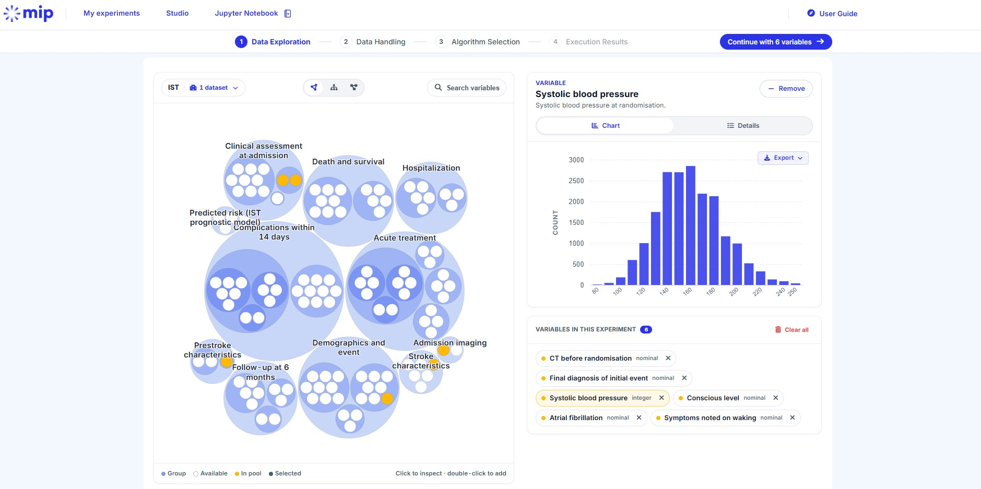



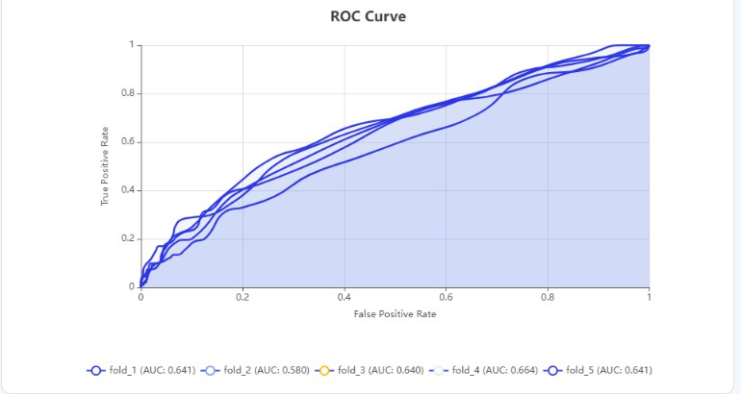
Learning the platform takes an afternoon
LAST WEEK IN HEIDELBERG
EBRAINS hands-on training on MIP 9.2, built on the International Stroke Trial. Three guided sessions, each with expected results:
Recognising a stroke: FAST
40 minutes, filters and histograms only. Which strokes the FAST test would miss: 938, or 4.8%, mostly in the posterior circulation.
Who survives a stroke?
30 minutes, one Cox model. Age, not sex, explains the women's excess deaths: the lesson of confounding in one output.
Bleed or clot?
MIP 9.2, the version you will use: four steps from data to result, in the browser or in a notebook. The screenshot is the stroke trial on the Public MIP.
One logistic regression, then a cross-validated ROC curve. The bedside cannot replace the brain scan, and the model says so honestly.
If a mixed audience learns it in an afternoon, so will an ED researcher. The same material, with eCREAM's own data, is the onboarding of the UC1 analysts.
Notes:
[1 min] Last week's EBRAINS training in Heidelberg ran on MIP 9.2 with the stroke trial dataset. The point for this audience: a mixed group learns the platform in an afternoon, with scenarios that start from a question everyone knows and end with a model. Fill in who attended and how it went.

Slide 16



Click through it or script it: the same engine answers
POINT AND CLICK, OR CODE
The web interface
The Jupyter notebook, since MIP 9.2
for clinicians and most users; no code, nothing to install
for analysts, and for PIs with the AI assistant
Four steps: data exploration, data handling, algorithm selection, results.
Every run is a saved experiment: re-opened, edited, shared.
The demo you just saw.
import mip
client = mip.Client.from_env()
dm = client.catalog().data_model("UC1")
delay = dm.variables["Door to doctor"]
tloc = dm.datasets["TLOC5K"]
dysp = dm.datasets["DYSP5K"]
aset = dm.select(datasets=[tloc, dysp],
variables=[delay, sex, age])
pipe = mip.Pipeline(analysis_set=aset,
handle_missing=drop)
pipe.describe()
pipe.t_test(variable=delay, group_by=dataset)
Same calls, same engine: describe, histograms, tests, regressions, pipelines.
Same answers: the notebook talks to the platform, never to a node; it receives statistics, nothing more.
Reproducible scripts for the UC1 analyses.
MIP 9.2, step 1 of 4: data exploration
AI LLM assistance in the notebook: a PI states the analysis protocol in plain medical language; the assistant writes the Python and runs it on the platform, federated results included. Vibe coding for the UC1 analyses, with an open-source model today and more options to come. It works through the notebook, so it gets exactly what the user gets: statistics, never data.
AVAILABLE IN 9.2
Same governance, same guarantees, whichever way you work. The notebook adds reproducibility and flexibility for the UC1 analysts; the AI assistant adds speed and reach, not access.
Notes:
[1 min] Two ways to work with the same platform. The web interface is what the demo showed: four steps, no code, every run saved as an experiment. Since version 9.2 there is also a Jupyter notebook with a Python client: the same federated calls, composed in code, for the analysts who will run the UC1 programme; it talks to the platform, never to a node, and receives the same statistics as the web interface. And the thing this consortium will ask about: AI in the notebook. It is there in 9.2 and fully available: an assistant inside the notebook, backed today by an open-source model hosted by the operator, with more options to come. A PI can state the analysis protocol in medical language and have the Python written and run on the platform, federated results included: vibe coding for the UC1 analyses. The design point is that the assistant acts through the notebook, so it can never see more than the user: statistics, never data.

Slide 17









Two ways to join the federation
FOR THE NODE DECISION · WHERE A PARTNER'S DATA WOULD SIT
eCREAM MIP Federation
one hub at CSCS, Lugano; one set of accredited users
one outbound-only encrypted link; only statistics leave
inside the same secured cluster; nodes never see each other
A node at your hospital
A node hosted at CSCS, Lugano
YOU OPERATE IT, WITH CHUV SUPPORT
CHUV OPERATES IT FOR YOU
your hospital, your firewall
Your data never leave your institution
MIP cluster at CSCS
Your dataset on dedicated storage in the MIP cluster, operated by CHUV
one anonymized csv, under a DTA
partner A
MIP node
computes here
A small server (2 cores, 8 GB, 40 GB); CHUV installs and supports it
A data transfer agreement for anonymized data, as IRFMN signed in 2025
yours
No transfer: you remain the controller, under the federation's rules
Nothing to install: one anonymized csv per dataset; an update replaces it
your dataset
anonymized, harmonized
your hospital
partner B
Suits a partner with IT capacity and one outbound connection allowed
separate storage per provider
Suits a partner without on-premises IT, or not wanting to run a server
Either way: your dataset harmonized to the eCREAM data model, the same five guarantees, one federation queried as a whole by the same accredited users. The choice is where the server stands, not what anyone can see.
Notes:
[1 min] The question we will discuss here: where would a partner's data sit. Two options, side by side. A node at your hospital: the data never leave, a small server, one outbound-only link, CHUV installs and supports it, no transfer agreement because nothing is transferred. Or a node hosted at CSCS: your dataset in its own compartment inside the MIP cluster, operated by CHUV under a data transfer agreement for anonymized data, which is how the Italian data are handled; nothing to run on your side. Same data model, same guarantees, same federation either way: the choice is operational, not about what anyone can see. Both have precedents: FERES registries are hosted at CSCS; the Frontiers paper describes the remote-node pattern.

Slide 18




Three decisions, and next steps to discuss at Košice
NEXT
1
First real extract
Which EDs, which date?
What follows
One or two EDs, structured fields only, no waiting for the NLP output; empty columns are fine. CHUV writes the mapping, anonymization and validation scripts; IRFMN runs them and sends the output. Quality report back within days.
CDE v2 with the revised dictionary: chief complaint, principal diagnosis, a "discharged" value
The other countries' datasets
Accredit the end-users: EBRAINS sign-up, then eCREAM accreditation and overall governance rules
2
Which model, and when?
A MIP node at home, behind your firewall with an outbound-only link, or a hosted node at CSCS. Same model, same guarantees, same federation either way.
The Public MIP subset: Define list of variables and cohort
3
The UC1 analyses on the platform
Which analyses protocols ?
Define now which analyses run federated. Notebooks give flexibility; a new federated algorithm needs lead time.
NLP-derived variables, as WP1 releases them
Notes:
[1.5 min] The ask of this talk. One: the first real extract, in discussion with IRFMN and Astir since last week; we do the preparation work, they run the scripts, the data stay with them until anonymized. Two: the plan for the other countries, node at home or hosted at CSCS, both are supported, and the sooner it is settled the better. Three: define the UC1 analyses to run on the platform early, so that the platform does not miss anything; notebooks give flexibility, but an extra federated algorithm takes lead time.

Slide 19



Everyone's data,
no one's risk.
The platform is running, the agreement is signed, the model is loaded, the method is validated. What it needs now is the data flowing in, and your decisions on where they sit and what we ask of them.
ecream.hbpmip.link
hbpmip.link
datacatalogue.mip.ebrains.eu
the eCREAM federation, accredited users
the Public MIP, free EBRAINS account
every federation's data model, open
Melissargos G, et al. Front Disaster Emerg Med 2026;4:1748193 · Salerno A, Melissargos G, et al. Eur J Neurol 2026;33(8):e70715
georges.melissargos@chuv.ch · CHUV, NeuroDigital, Lausanne
Notes:
[0.5 min] Close on the title. Then take questions. The three decisions slide is the one to come back to in the discussion.

Slide 20
The seventeen EDs prepared in the data model
APPENDIX
Code | Hospital | Country
PG23 | Papa Giovanni XXIII, Bergamo | Italy
POMI | Policlinico Ospedale Maggiore, Milan | Italy
NIGU | ASST Grande Ospedale Metropolitano Niguarda, Milan | Italy
ABAL | AO SS. Antonio e Biagio e C. Arrigo, Alessandria | Italy
SLGO | San Luigi Gonzaga, Orbassano | Italy
ODIR | Ospedale degli Infermi, Rivoli | Italy
OSGB | Ospedale San Giovanni Bosco, Torino | Italy
OMLO | Ospedale Maggiore, Lodi | Italy
OSAV | Ospedale Sant'Andrea, Vercelli | Italy
TO4 | ASL TO4, Chivasso | Italy
OMBO | Ospedale Maggiore Carlo Alberto Pizzardi, Bologna | Italy
SMGP | Santa Maria delle Grazie, Pozzuoli | Italy
POGR | Presidio Ospedaliero Gaspare Rodolico, Catania | Italy
UKCM | Univerzitetni klinični center Maribor | Slovenia
UJKR | Uniwersytet Jagielloński, Kraków (partner, not an ED) | Poland
MHKR | Hospital Emergency Ward, Military Hospital, Kraków | Poland
UHKR | University Hospital Krakow | Poland
Notes:
Reference: the per-ED container datasets prepared in the federation's registry, one per hospital, ready to receive the real extractions. The roster grows as further sites in Greece, Slovakia and the UK activate.

Slide 21
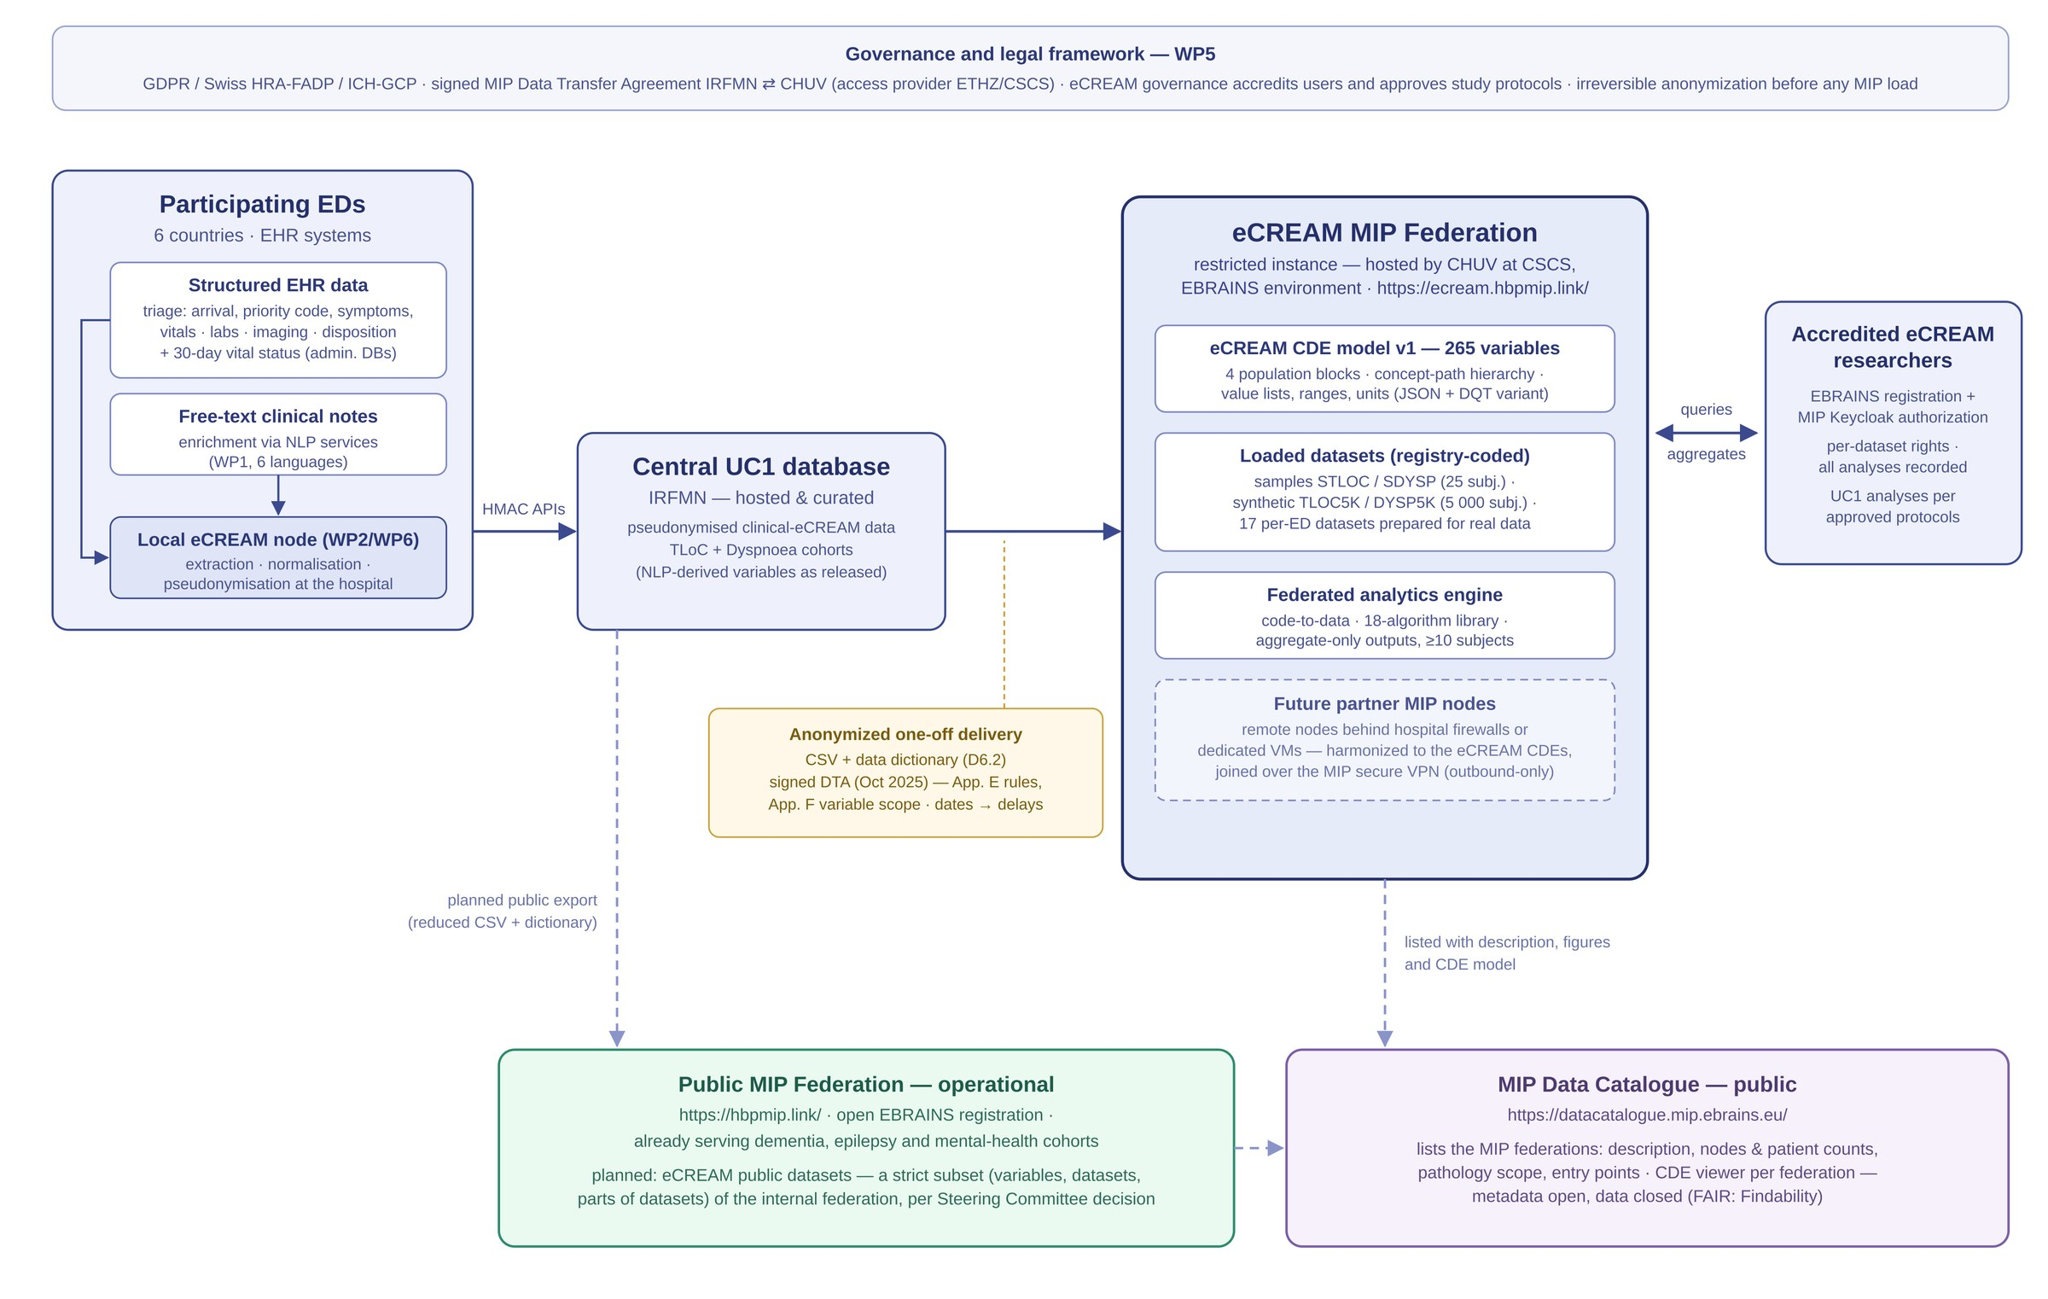
Architecture of the eCREAM MIP integration (D5.2, Figure 1)
APPENDIX
Notes:
The full data pathway: hospitals extract and pseudonymise locally; IRFMN curates the central UC1 database; one anonymized delivery under the DTA loads the federation; accredited researchers send queries and get statistics back; the public branch and the catalogue at the bottom.

Slide 22
Live demo: exact settings, in order
APPENDIX
Datasets
UC1: tick Synthetic Dyspnea dataset and Synthetic TLoC dataset (5,000 subjects each).
Variable
Door to doctor taking on of patient (ALL_PATIENTS, TimeMetrics). Covariates: Sex, Age.
Filter
None: 10,000 records, no missing values on the delay variable.
Preprocessing
Defaults.
Algorithm 1
Independent t-test, grouping variable = Dataset Registry origin. Expected: 47.8 versus 105.3 minutes, difference near 57 minutes.
Algorithm 2
Chi-squared Test, Sex by Dataset Registry origin. Expected: 68% male in dyspnoea versus 48% in TLoC.
Optional third
Logistic Regression, 30-day mortality (positive class Dead) on Age, Sex, SpO2 in AA, 3-fold cross-validation. Expect an AUC near 0.5, and say why: synthetic data carry no cross-block signal.
Save
Save as "Košice demo, dyspnoea vs TLoC door-to-doctor", then show it in My experiments.
Notes:
Known artefacts of the synthetic data, in case someone looks closely: triage code and mode of arrival are uniform (the generator randomised them), door-to-nurse is almost always zero, and the mode-of-exit value set has no discharged value in v1 (fixed in the dictionary revision).

Slide 23

References and links
APPENDIX
Melissargos G, Schaffhauser B, Mailli E, Ducouret P, Bertolini G, Michel P, Rujano MA, Ghilardi GI, Salerno A, Bastic V, Dhallenne J, Filippopolitis K, Katsouli M-O, Karampatsis T-M, Glenis A, Ioannidis Y, Ryvlin P. Deploying the Medical Informatics Platform for cross-border federated analytics in FERES and eCREAM. Front Disaster Emerg Med. 2026;4:1748193. doi:10.3389/femer.2026.1748193
Salerno A, Melissargos G, Katan M, Knoflach M, Kiechl S, Harbison J, Renieri L, Toni D, Palaiodimou L, Tsivgoulis G, Ktenidis A, Mailis T, Ioannidis Y, Michel P, Ryvlin P, on behalf of the FERES collaborators. Federating European REgistries for Stroke: Principles, Data Model and Future Perspectives for a Federated Analysis of Multiple Prospective Stroke Registries. Eur J Neurol. 2026;33(8):e70715. doi:10.1111/ene.70715
eCREAM D5.2, Integration of db and services to the MIP, v1.0, August 2026 (public deliverable, WP5, Task 5.3, lead CHUV with IRFMN and ECRIN). Grant Agreement 101057726.
eCREAM MIP Federation: https://ecream.hbpmip.link · Public MIP: https://hbpmip.link · MIP Data Catalogue: https://datacatalogue.mip.ebrains.eu · EBRAINS sign-up: https://ebrains.eu/sign-up
MIP platform source and documentation: https://github.com/Medical-Informatics-Platform/mip · MIP Jupyter workspace: https://github.com/madgik/mip-jupyter

